Slide 1
An introduction into Rest Assured & WireMock
By rick van osch & loek ehren

Slide 2
Contents
What is WireMock?
What is Rest Assured?
Why use them?
Demos
Exercises
Discussion
Questions

Slide 3
What is WireMock?
Simulator for HTTP-based APIs
Used within Java application, JUnit test, Servlet container or as standalone process.
Open source
http://wiremock.org

Slide 4
What is WireMock?
In Java(Using JUnit):
In Java(Without JUnit):
Standalone:

Slide 5
What is WireMock?
Mocking responses in code…
Fluent Interface
Simple

Slide 6
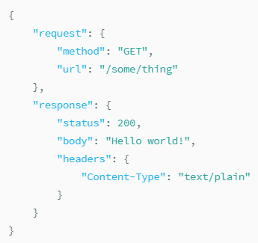
What is WireMock?
or JSON files(at runtime)
POST to http://<host>:<port>/__admin/mappings or placed with a .json extension in src/test/resourcesmappings directory

Slide 7
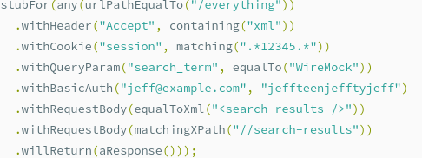
What is WireMock?

Slide 8
What is WireMock?
Stateful behaviour to mocks
More complex test cases

Slide 9
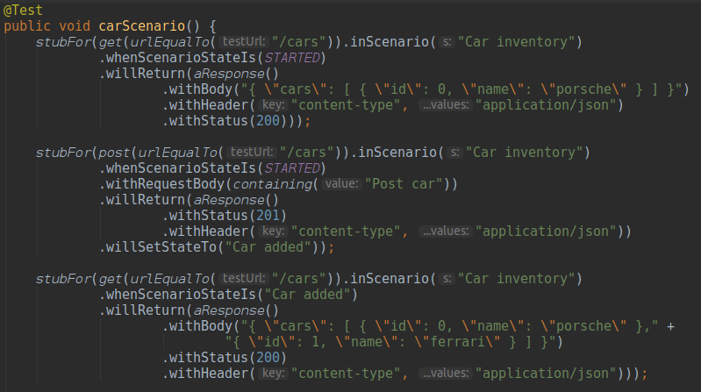
What is WireMock?

